Slide 1

A-Z Pharmacy

Slide 2

Introduction
We Have Made A Simple Application For A Pharmacy That Contains A Set Of Sections That
Contain Medical Supplies And Medical Accessories

Slide 3


Problem Definition
To Purchase Any Of The Medical Supplies And Others Requires Time, Effort And Costs, And
It Is Difficult For People With Special Needs In Direct Dealings, Some Of Them Want To Hide Their Identity

Slide 4

System Goals
Online Pharmacies Offer Better Pricing Than Offline Stores, With Increased Access, Lower Transaction And Product Costs, Convenience And Greater Anonymity For Consumers. They Offer Accessibility To People With Limited Mobility.

Slide 5
System Overview Items
Splash Screen
Login
Sections
Sub sections
Items in sub sections
Payment
Sign Up

Slide 6
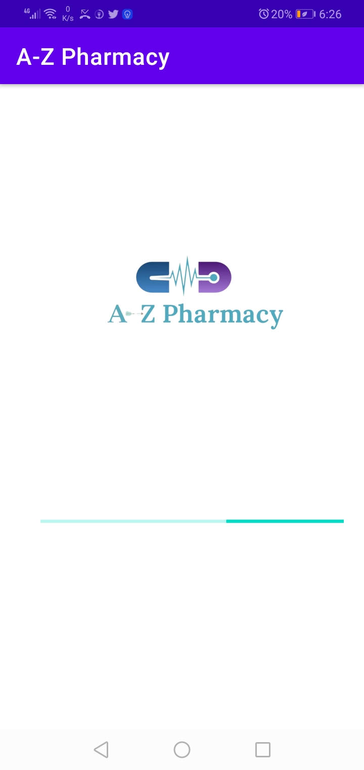
Splash Screen
The First Screen That Appears
When The Application Is Launched

Slide 7
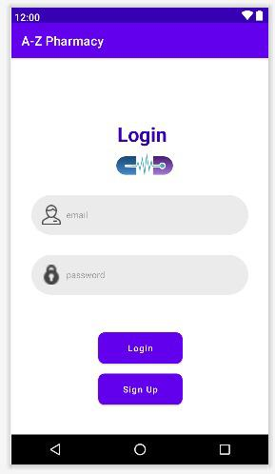
Login
You Can Login If You Have An Account
.

Slide 8
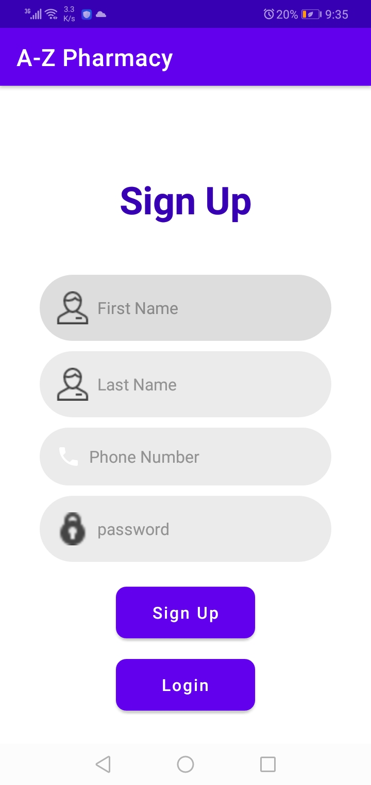
Sign Up
If You Are A New Member You Should Sign Up To Be One Of Our Small Community

Slide 9
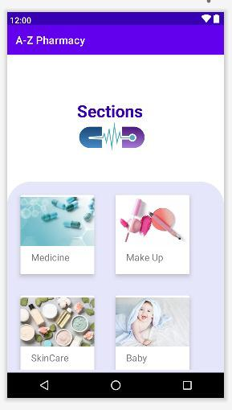
Sections
This Screen Show Our Sections
Consist Of 4 Sections

Slide 10
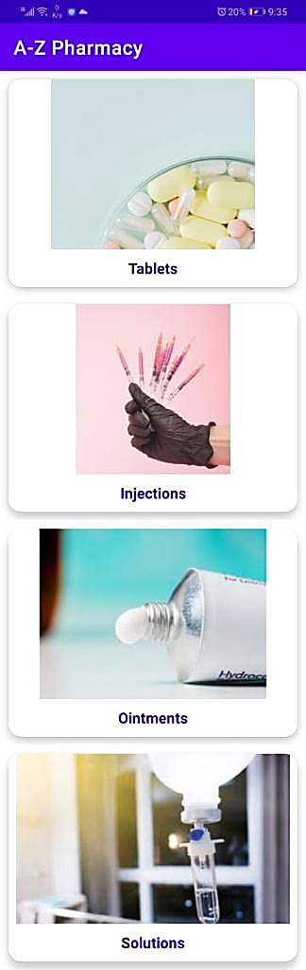
Sub Section Of Medicine
This Show Our Sub Sections In Medicine Section

Slide 11
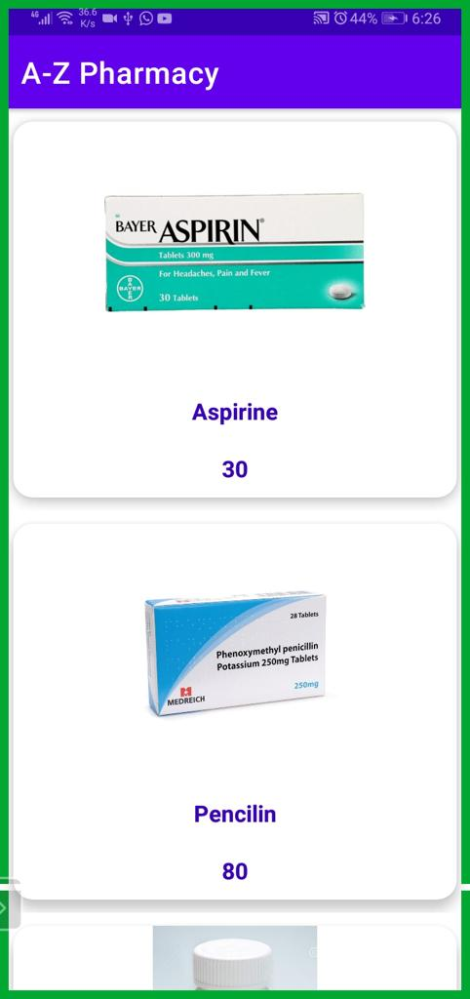
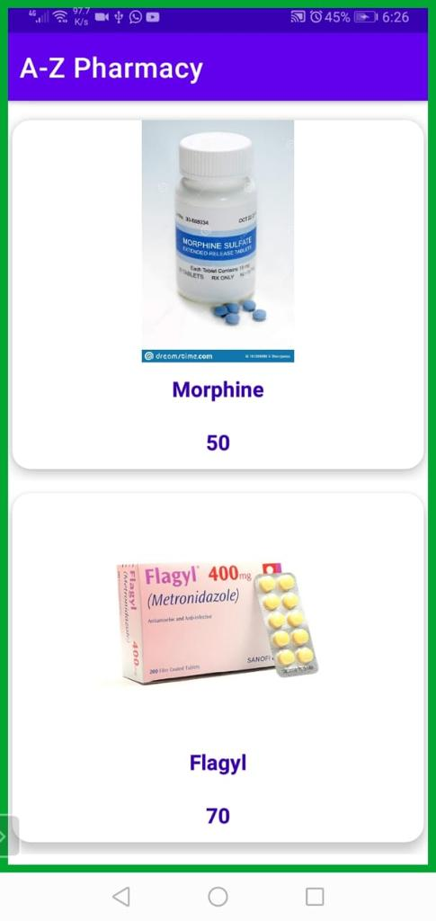
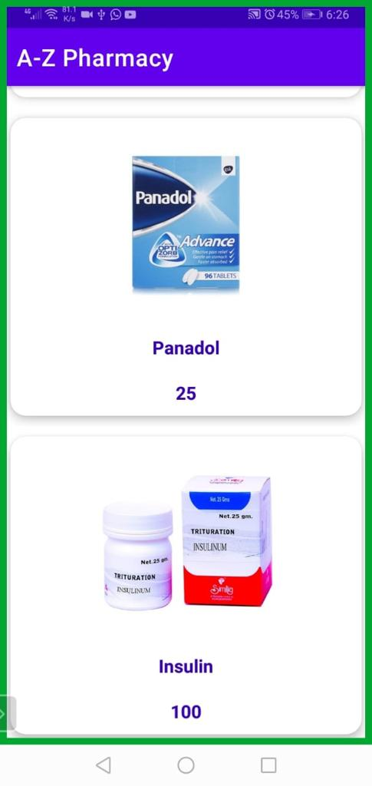
Sub Section Items

Slide 12
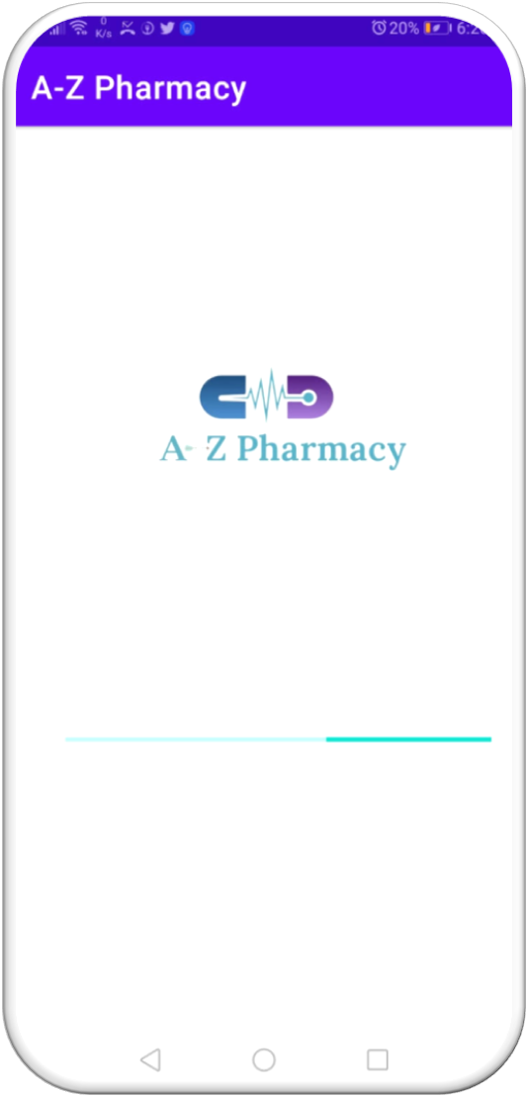
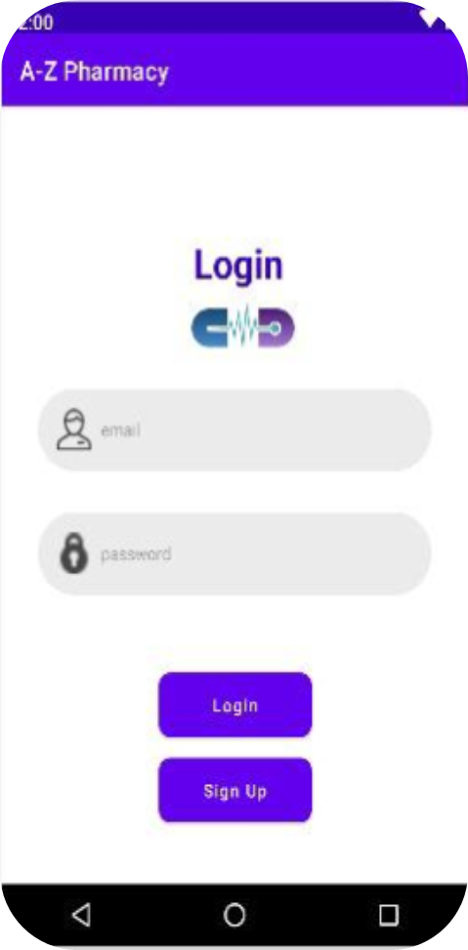
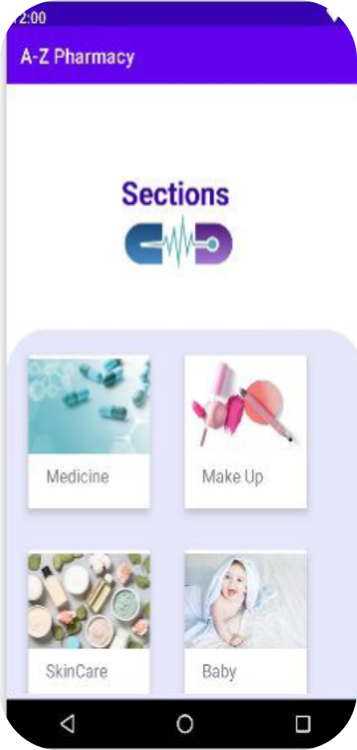
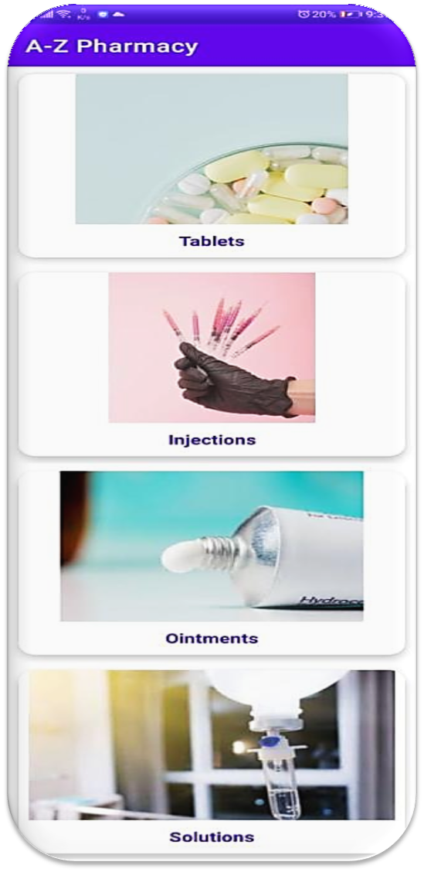
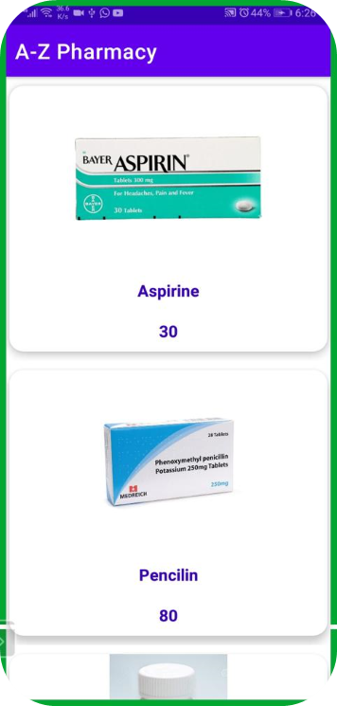
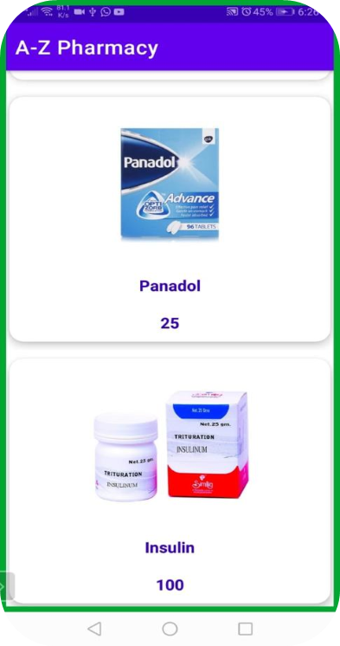
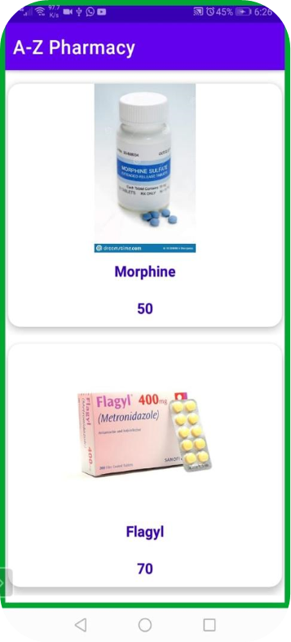
Overview Of Application
splash
login
Sections
Tablets
items

Slide 13




Team Members
Sara Usama
Mayar Ashraf
Alaa waleed
Yasmeen Ahmed

